Slide 1
CSE438
APPLIED DATA SCIENCE FOR PRACTITIONERS
A Comparative Study of Business Intelligence and Artiﬁcial Intelligence with Big Data Analytics
Presented by: Nabila Islam Borno
ID: 20301117
Section: 1

Slide 2

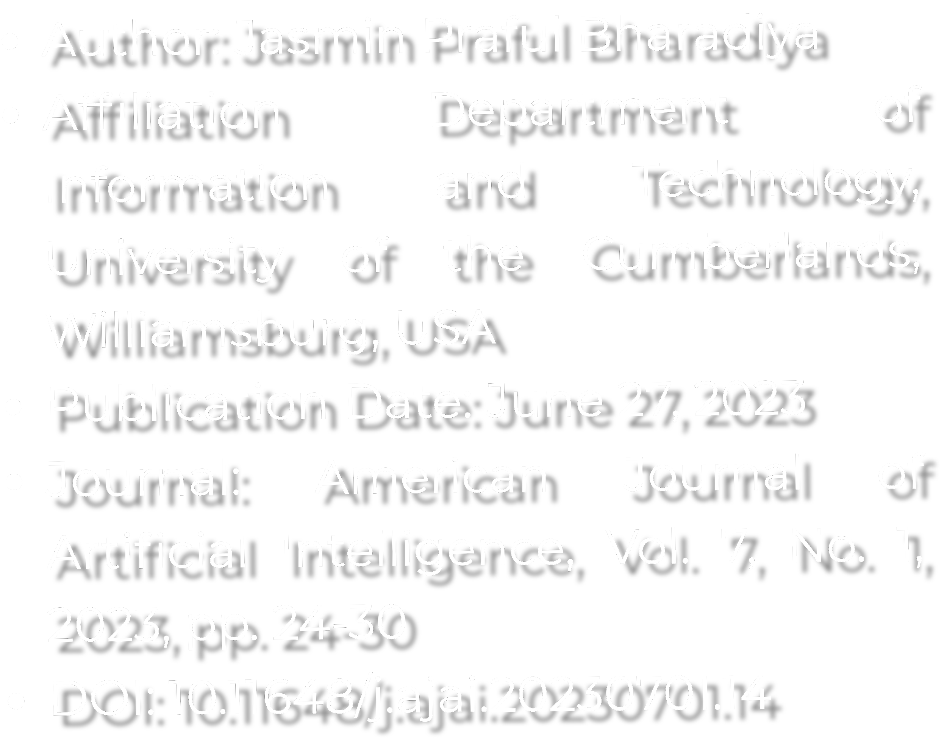

Title: A Comparative Study of Business Intelligence and Artificial Intelligence with Big Data Analytics

Slide 3

Abstract
Business Intelligence (BI) aims to increase the timeliness and quality of data for better decision-making.
BI helps analyze market changes, consumer behavior,
and corporate capabilities. Data mining extracts valuable information from data, such as clustering, data summarization, and anomaly detection.
Advances in data warehousing, data
purification, and hardware have enriched the BI environment.

Slide 4

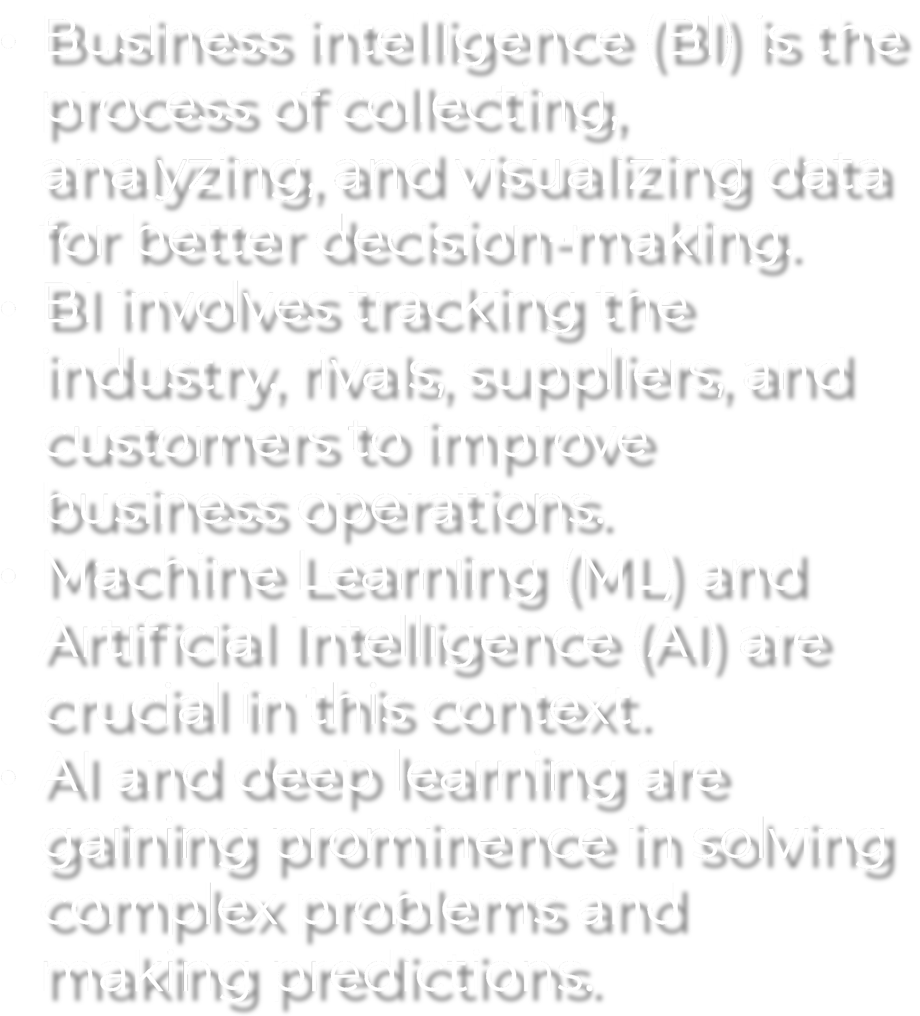


Introduction

Slide 5
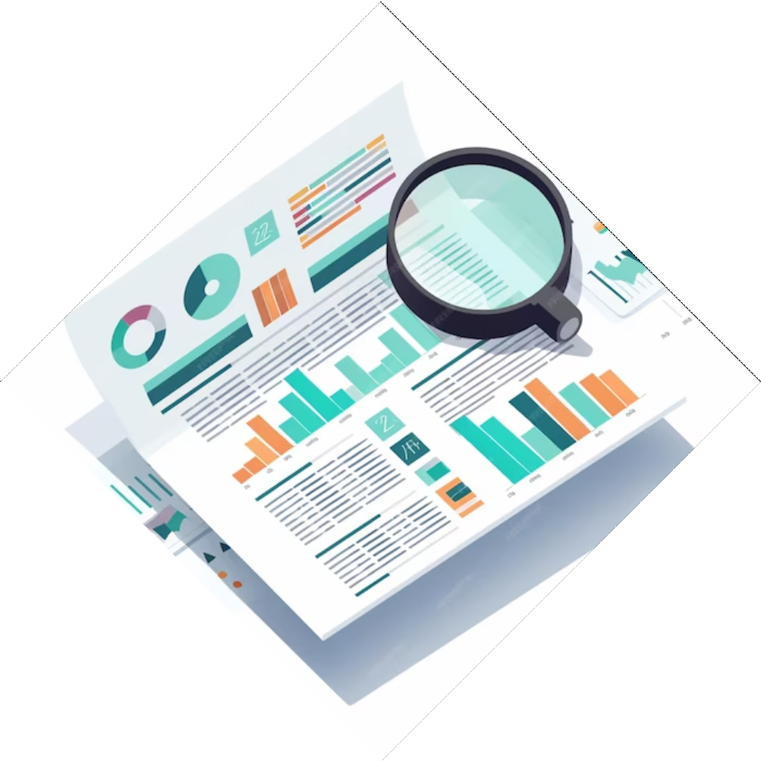
Business Intelligence (BI)
BI provides actionable information to decision- makers.
Tools and strategies for data collection, analysis, and visualization aid executive decision- making.
Customized reports and dashboards are created to deliver information effectively.
BI is a high-priority investment in the business world.

Slide 6
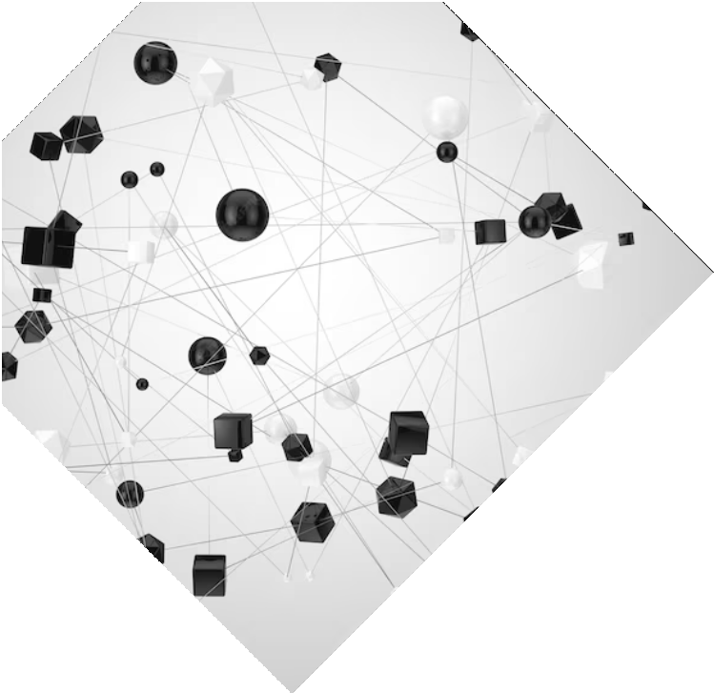

Machine Learning (ML)
ML is a subset of AI focused on teaching machines to solve problems through historical examples.
Various ML techniques include decision trees, support vector machines, and Naive Bayes.
ML is a growing technology in
automating complex decision-making processes.

Slide 7

Deep Learning
Deep learning, a subtype of ML,
simulates human brain data processing.
It uses neural networks and can process vast amounts of data.
It's gaining popularity in various industries for its capabilities.
Hardware resources like GPUs play a significant role in deep learning.

Slide 8
Artificial Intelligence (AI)
AI is used to understand and control
complex business processes.
It helps in improving data quality and timeliness for better decision-making. AI technology has been evolving rapidly, with increasing applications.

Slide 9

Role of Artificial Intelligence in Data Analytics
AI and data analytics are hot topics globally.
AI is revolutionizing various industries and providing solutions.
In 2016, image recognition dominated the AI market.

Slide 10

Software and Hardware Resources
Hardware resources, such as NVIDIA and INTEL GPUs, play a crucial role in deep learning.
Software tools and libraries like TensorFlow, Caffe, and Theano are essential for AI and deep learning.
AI market is expected to grow rapidly in the next ﬁve years.

Slide 11



Research Challenges
Challenges in the ﬁeld of AI include the computational complexity of reasoning problems.
AI researchers have developed solutions to deal with information uncertainty and incompleteness.

Slide 12


Security
Security is a critical concern when implementing AI and BI in dynamic environments.
Selecting effective solutions and ensuring data quality is vital for success.

Slide 13
Conclusion
Big data, business intelligence, and artiﬁcial intelligence are essential for decision-making and forecasting.
Strong leadership and training can enhance the potential of these technologies.
The growth potential in these areas is substantial.

Slide 14
Thanks!
Do you have any questions?
nabila.islam.borno@g.bracu. ac.bd.com

